Slide 2
Christian, Never Give Up!
North Settle Convention – April 8, 2018
Notes:
Important promise
Why does the New Creation have cares?

Slide 3
Galatians 6:9
Let us not be weary in well doing: for in due season we shall reap, if we faint not.– King James
Let us not lose heart in doing good, for we will reap at harvest time, if we do not give up.– NASV, NRSV

Slide 4
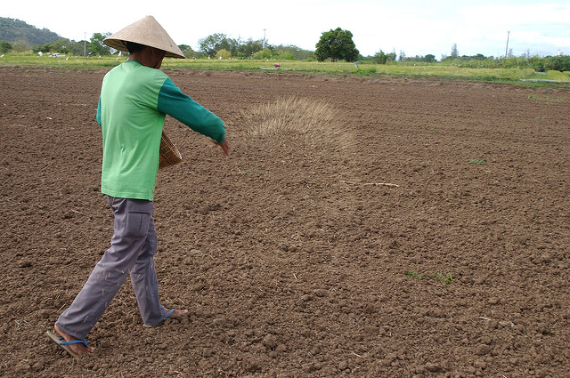
Galatians 6:7
For whatever a man sows, this he will also reap.
New American Standard
Notes:
Consider context: Galatians 6:7-10
Galatians 6:7-10 - Do not be deceived, God is not mocked; for whatever a man sows, this he will also reap.
For the one who sows to his own flesh will from the flesh reap corruption, but the one who sows to the Spirit will from the Spirit reap eternal life.
Let us not lose heart in well doing, for we will reap at harvest time, if we do not give up.
So then, while we have opportunity, let us do good to all, and especially to those who are of the household of the faith.
Foundation principle. You reap what you sow. The world refers to this as cause and effect principle.

Slide 5
Heart Gardening
Few realize to what extent we form our own characters, to what extent our minds, our affections, are gardens – R4828
      Weed seed = sin
      Vegetable seed = moral/practical qualities
      Fruit seed = heavenly/spiritual graces
Notes:
R4828 - FEW REALIZE THE EXTENT OF PERSONAL RESPONSIBILITY FOR CHARACTER
Comparatively few realize to what extent we form our own characters, to what extent our minds, our affections, are gardens in which we may plant either the thorns and thistles of sin, or the merely moral and practical qualities corresponding to the useful vegetables, or those seeds which produce the fragrant and beautiful flowers and fruits which more particularly represent the heavenly and spiritual graces. Whatsoever a man soweth he shall also reap, whether he sow to the flesh or to the spirit. Whoever, therefore, seeks for the heavenly things, joint-heirship in the Kingdom, etc., must plant, or set out in his mind, in his affections, those qualities and graces which the Lord marks out as essential to the development of characters such as will be "meet for the inheritance of the saints in light."

Slide 6
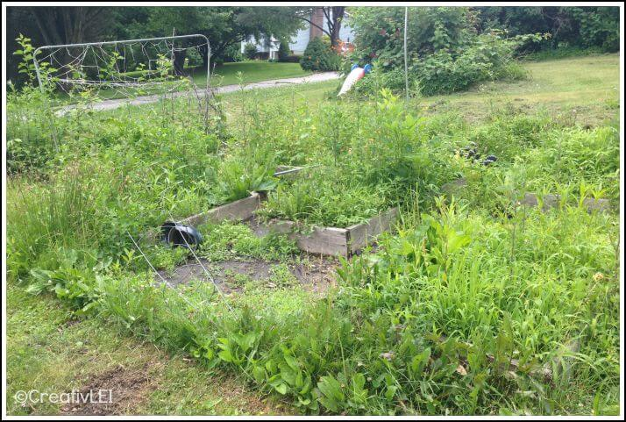
For the one who sows to his own flesh will from the flesh reap corruption Galatians 6:8 - New American Standard

Slide 7

But the one who sows to the Spirit will from the Spirit reap eternal life. Galatians 6:8 - NAS
Notes:
?

Slide 8
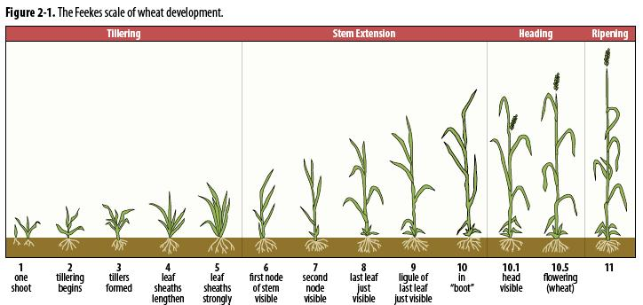
Bear Fruit with Patience . . . . In Due Season, Reap
Notes:
In Luke’s account of the parable of the sower, 8:15:
But that on the good ground are they, which in an honest and good heart, having heard the word, keep it, and bring forth fruit with patience.
in due season we shall reap, if we faint not. KJV
Romans 2:6-9 God will render to every man according to his deeds: To them who by patient continuance in well doing seek for glory and honour and immortality, eternal life unto them that are contentious, and do not obey the truth, but obey unrighteousness, indignation and wrath, Tribulation and anguish, upon every soul of man that doeth evil, of the Jew first, and also of the Gentile

Slide 9
What is “Well Doing”?
Galatians 6:9 - Let us not lose heart in well doing, for we will reap at harvest time, if we do not give up.
Inward Focus – Sowing to the Spirit
6:10 - So then, while we have opportunity, let us do good to all, especially to those who are of the household of the faith.
Outward Focus – Blessing Others
Notes:
Good – verse 9 – Kalos – beautiful, as an outward sign of the inward good.
Good – verse 10 – Agathos – good in the widest and most colorless of all Greek words translated good - good whether it is seen to be good or not.

Slide 10
What is “Well Doing” in Blessing Others?
Lift up the gospel light in this dark world
Encourage those attracted to the gospel light
Prove loyal to God and Jesus when put to the test
Prepared for the future work of blessing the world
- R2414 – The Correct View of the Church’s Mission
Notes:
Does not mention
worldly reforms, moral uplift, revivals, certainly not politics
Highest and best use

Slide 11
Causes of Christian Weariness
Personal failings, disappointing God and Jesus.
Enduring opposition and long-standing trials.
Not receiving God’s chastisements and corrections.
Observing other’s heavy experiences.
Failure of expectations.
Anything that interferes with our personal communion with God and Jesus.
Notes:
Weariness because of
Hands full with the Lord’s work, seems that others could help
Seeming delays in God’s Plan
Physical illness
Family problems
Misunderstandings
Unrealized desires to serve

Slide 12
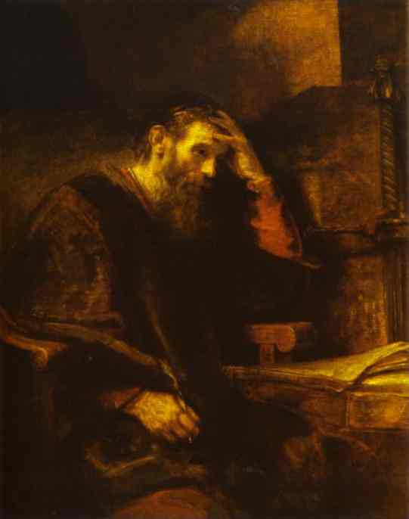
Causes of Weariness
Personal Failings
When I would do good, evil is present with me. . .
Wretched man that I am, who will deliver me from this body of death?
Romans 7:21-25
Notes:
Romans 7:21 I find then a law, that, when I would do good, evil is present with me. 22 For I delight in the law of God after the inward man: 23 But I see another law in my members, warring against the law of my mind, and bringing me into captivity to the law of sin which is in my members. 24 O wretched man that I am! who shall deliver me from the body of this death? 25 I thank God through Jesus Christ our Lord. So then with the mind I myself serve the law of God; but with the flesh the law of sin.

Slide 13
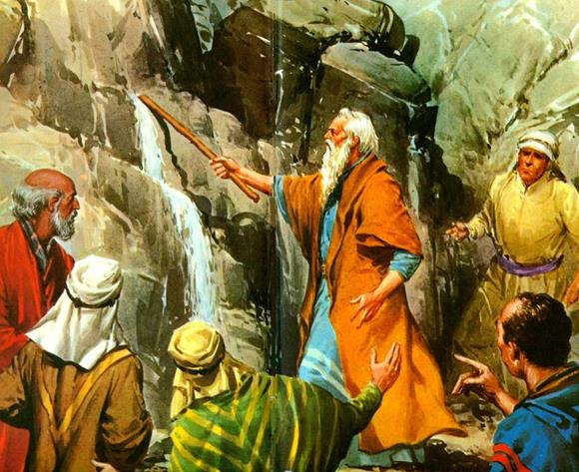
Causes of Weariness
Long-Standing Trials
Moses smites the rock a second time
Numbers 20:1-13 NRSV
Notes:
Numbers 20:7 And the LORD spake unto Moses, saying, 8 Take the rod, and gather thou the assembly together, thou, and Aaron thy brother, and speak ye unto the rock before their eyes; and it shall give forth his water, and thou shalt bring forth to them water out of the rock: so thou shalt give the congregation and their beasts drink. 9 And Moses took the rod from before the LORD, as he commanded him. 10 And Moses and Aaron gathered the congregation together before the rock, and he said unto them, Hear now, ye rebels; must we fetch you water out of this rock? 11 And Moses lifted up his hand, and with his rod he smote the rock twice: and the water came out abundantly, and the congregation drank, and their beasts also. 12 And the LORD spake unto Moses and Aaron, Because ye believed me not, to sanctify me in the eyes of the children of Israel, therefore ye shall not bring this congregation into the land which I have given them.
How could the meekest man in all the earth says “must we fetch water for your out of this rock?”

Slide 14
My child, do not despise the Lord’s discipline or be weary of His reproof. – Proverbs 3:11 NRSV
Causes of Weariness
Not Receiving God’s Corrections
He disciplines us for our good, in order that we may share His holiness. – Hebrews 12:10 NRSV
Notes:
My child, do not despise the Lord’s discipline or be weary of His reproof. For the Lord reproves the one he loves, as a father the son in whom he delights – Proverbs 3:11-12
Hebrews 12:5 And you have forgotten the exhortation that addresses you as children— "My child, do not regard lightly the discipline of the Lord, or lose heart when you are punished by him; 6 for the Lord disciplines those whom he loves, and chastises every child whom he accepts." 7 Endure trials for the sake of discipline. God is treating you as children; for what child is there whom a parent does not discipline? 8 If you do not have that discipline in which all children share, then you are illegitimate and not his children. 9 Moreover, we had human parents to discipline us, and we respected them. Should we not be even more willing to be subject to the Father of spirits and live? 10 For they disciplined us for a short time as seemed best to them, but he disciplines us for our good, in order that we may share his holiness. 11 Now, discipline always seems painful rather than pleasant at the time, but later it yields the peaceful fruit of righteousness to those who have been trained by it.

Slide 15
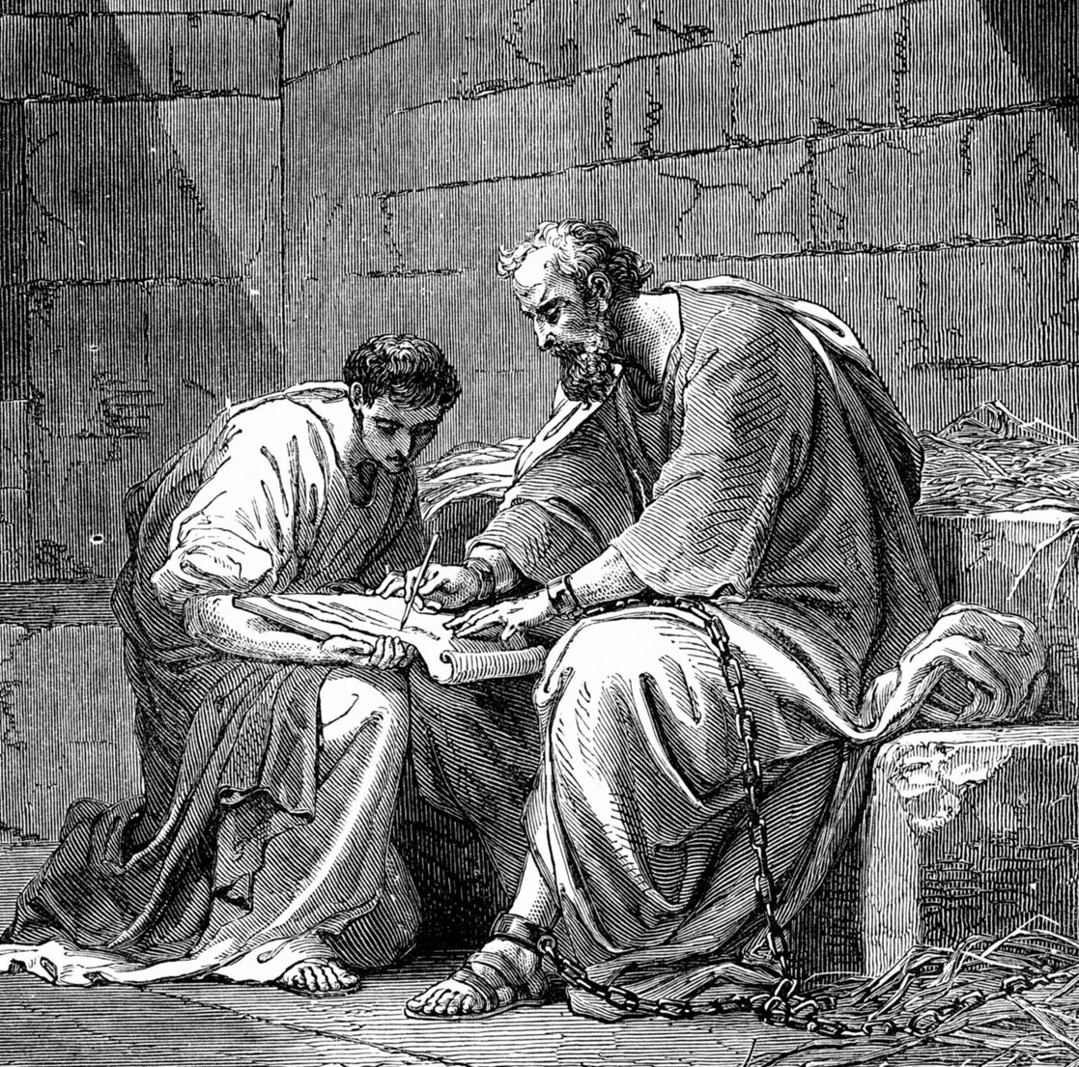
Causes of Weariness
Don’t “lose heart over my sufferings for you”.
– Ephesians 3:13 NRSV
Notes:
Ephesians 3:13 I pray therefore that you may not lose heart over my sufferings for you; they are your glory.

Slide 16
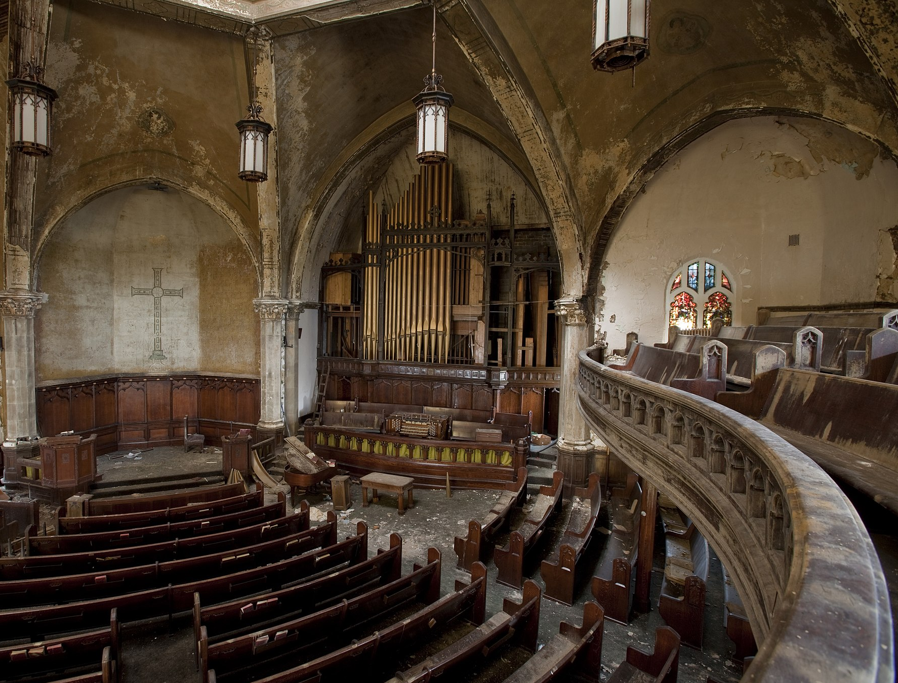
Causes of Weariness - Failure of Expectations
The people exhaust themselves for nothing
The nations weary themselves only for fire
Jeremiah 51:58 NRSV
Notes:
Jeremiah 51:8 Suddenly Babylon has fallen and is shattered; wail for her! Bring balm for her wound; perhaps she may be healed. 51:9 We tried to heal Babylon, but she could not be healed. Forsake her, and let each of us go to our own country; for her judgment has reached up to heaven and has been lifted up even to the skies.
Jeremiah 51:58 Thus says the Lord of hosts: The broad wall of Babylon shall be leveled to the ground, and her high gates shall be burned with fire. The peoples exhaust themselves for nothing, and the nations weary themselves only for fire.

Slide 17
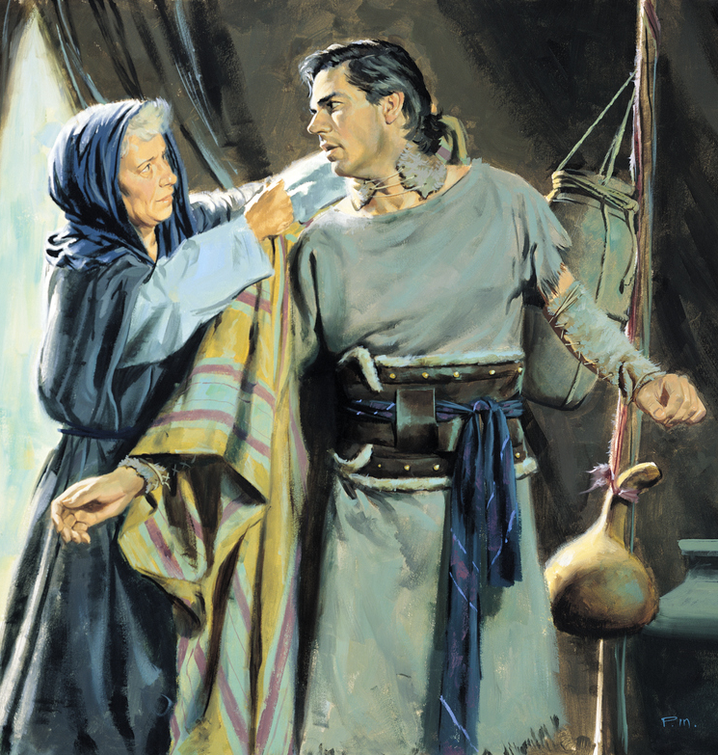
Causes of Weariness
Failure of Expectation
Rebekah wearied of life because of her Hittite daughter-in-laws
Genesis 27:46 NRSV
Notes:
41 So Esau bore a grudge against Jacob because of the blessing with which his father had blessed him; and Esau said to himself, “The days of mourning for my father are near; then I will kill my brother Jacob.” 42 Now when the words of her elder son Esau were reported to Rebekah, she sent and called her younger son Jacob, and said to him, “Behold your brother Esau is consoling himself concerning you by planning to kill you. 43 “Now therefore, my son, obey my voice, and arise, flee to Haran, to my brother Laban! 44 “Stay with him a few days, until your brother’s fury subsides, 45 until your brother’s anger against you subsides and he forgets what you did to him. Then I will send and get you from there. Why should I be bereaved of you both in one day?”
46 Rebekah said to Isaac, “I am tired of living because of the daughters of Heth; if Jacob takes a wife from the daughters of Heth, like these, from the daughters of the land, what good will my life be to me?”
Note that Esau had two Hittite wives at the time Gen 26:34.

Slide 18
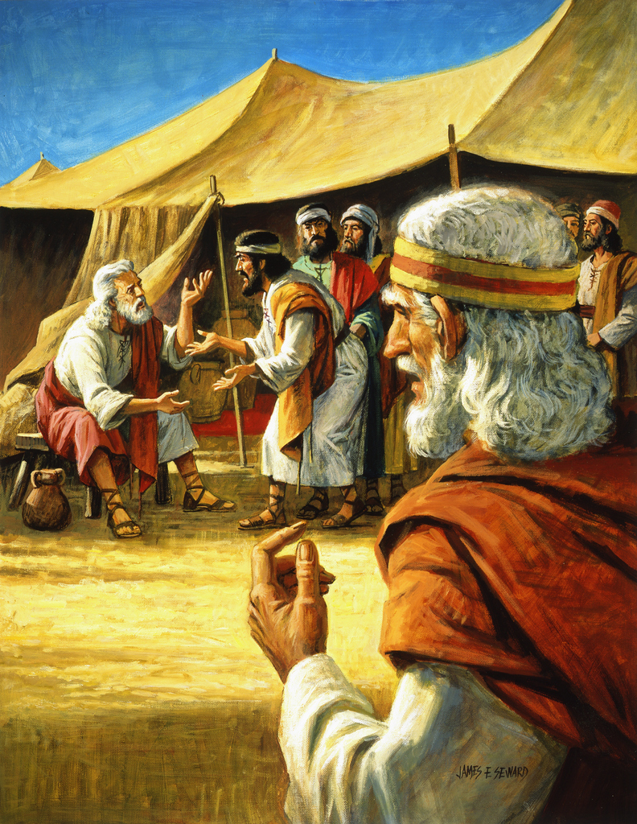
Causes of Weariness
Heavy Load, Little Help
The task is too heavy for you; you cannot do it alone.
Exodus 18:18 NRSV
Notes:
Genesis 18:14 When Moses' father-in-law saw all that he was doing for the people, he said, "What is this that you are doing for the people? Why do you sit alone, while all the people stand around you from morning until evening?" 15 Moses said to his father-in-law, "Because the people come to me to inquire of God. 16 When they have a dispute, they come to me and I decide between one person and another, and I make known to them the statutes and instructions of God." 17 Moses' father-in-law said to him, "What you are doing is not good. 18 You will surely wear yourself out, both you and these people with you. For the task is too heavy for you; you cannot do it alone. 19 Now listen to me. I will give you counsel, and God be with you! You should represent the people before God, and you should bring their cases before God; 20 teach them the statutes and instructions and make known to them the way they are to go and the things they are to do. 21 You should also look for able men among all the people, men who fear God, are trustworthy, and hate dishonest gain; set such men over them as officers over thousands, hundreds, fifties and tens. 22 Let them sit as judges for the people at all times; let them bring every important case to you, but decide every minor case themselves. So it will be easier for you, and they will bear the burden with you.

Slide 19
How long O Lord, holy and true, dost thou not judge and avenge our blood on them who dwell on the earth? Revelation 6:10 - KJV
Causes of Weariness
Seeming Delays in God’s Plan
Lord, how long shall the wicked, how long shall the wicked triumph? Psalm 94:3 - KJV

Slide 20
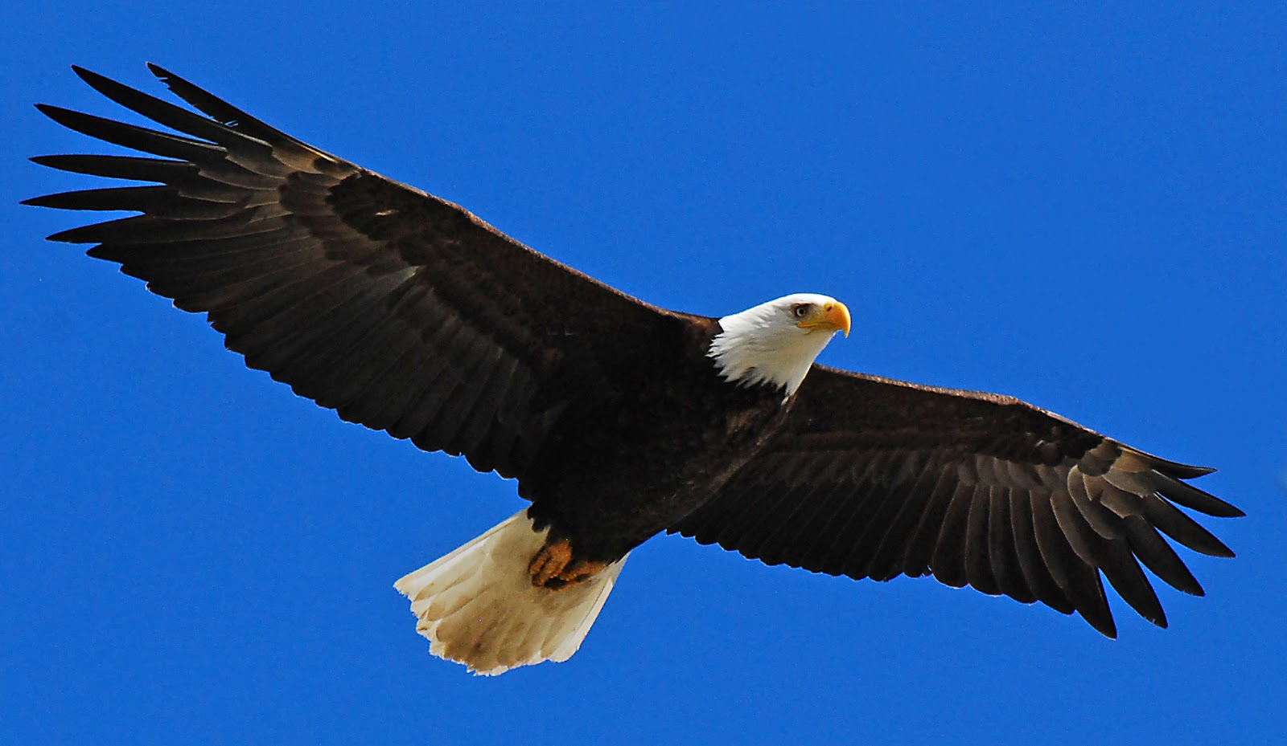
Overcoming Weariness
Those who wait for the Lord
shall renew their strength
Isaiah 40:31
they shall mount up
with wings like eagles
Notes:
Isaiah 40:28 Have you not known? Have you not heard? The Lord is the everlasting God, the Creator of the ends of the earth. He does not faint or grow weary; his understanding is unsearchable. 29 He gives power to the faint, and strengthens the powerless. 30 Even youths will faint and be weary, and the young will fall exhausted;
31 but those who wait for the Lord shall renew their strength, they shall mount up with wings like eagles, they shall run and not be weary, they shall walk and not faint.

Slide 21
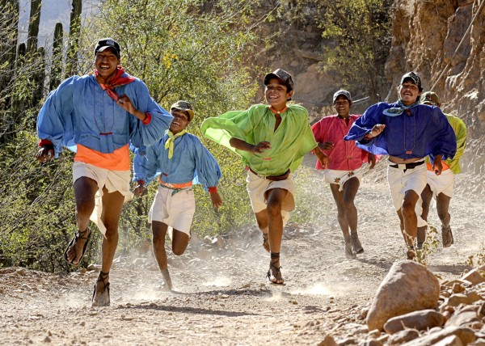
Overcoming Weariness
They shall run and not be weary
They shall walk and not faint
Isaiah 40:31
Notes:
Isaiah 40:28 Have you not known? Have you not heard? The Lord is the everlasting God, the Creator of the ends of the earth. He does not faint or grow weary; his understanding is unsearchable. 29 He gives power to the faint, and strengthens the powerless. 30 Even youths will faint and be weary, and the young will fall exhausted;
31 but those who wait for the Lord shall renew their strength, they shall mount up with wings like eagles, they shall run and not be weary, they shall walk and not faint.

Slide 22
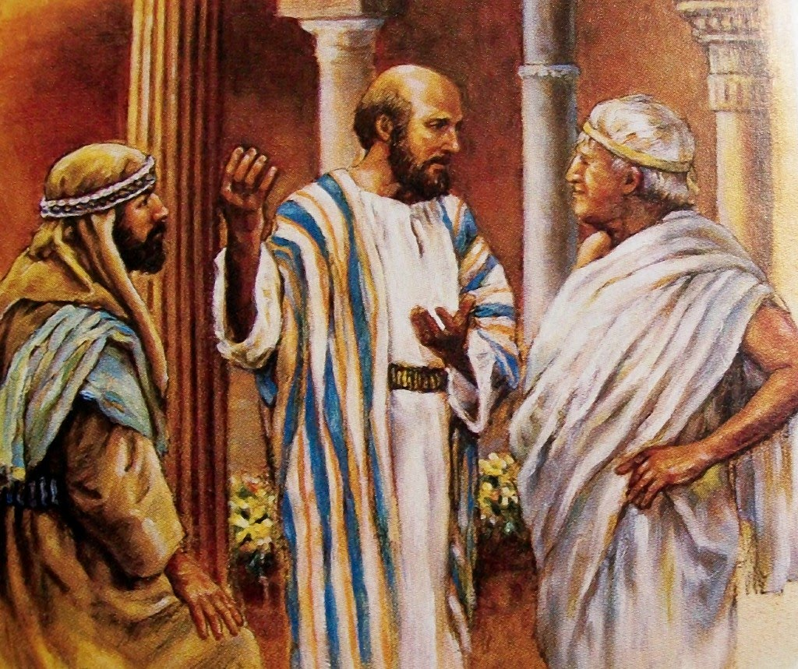
Overcoming Weariness
For which cause we faint not; but though our outward man perish, yet the inward man is renewed day by day.
2 Corinthians 4:16 MKJV
Notes:
2 Corinthians 4:7But we have this treasure in earthen vessels, that the excellency of the power may be of God, and not of us. 8We are troubled on every side, yet not distressed; we are perplexed, but not in despair; 9Persecuted, but not forsaken; cast down, but not destroyed; 10Always bearing about in the body the dying of the Lord Jesus, that the life also of Jesus might be made manifest in our body. 11For we who live are always delivered unto death for Jesus' sake, that the life also of Jesus might be made manifest in our mortal flesh. 12So then death works in us, but life in you.
13We having the same spirit of faith, according as it is written, I believed, and therefore have I spoken; we also believe, and therefore speak;
14Knowing that he who raised up the Lord Jesus shall raise up us also by Jesus, and shall present us with you.
15For all things are for your sakes, that the abundant grace might through the thanksgiving of many increase to the glory of God.
16For which cause we faint not; but though our outward man perish, yet the inward man is renewed day by day.
17For our light affliction, which is but for a moment, works for us a far more exceeding and eternal weight of glory; 18While we look not at the things which are seen, but at the things which are not seen: for the things which are seen are temporal; but the things which are not seen are eternal.

Slide 23
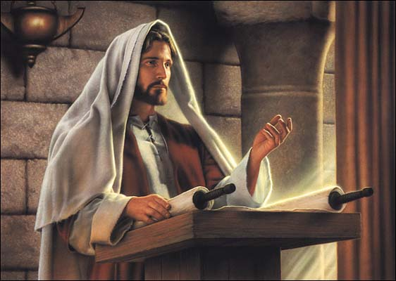
Overcoming Weariness
The Lord God has given me the tongue of a teacher, that I may know how to sustain the weary with a word.
Isaiah 50:4 NRSV

Slide 24
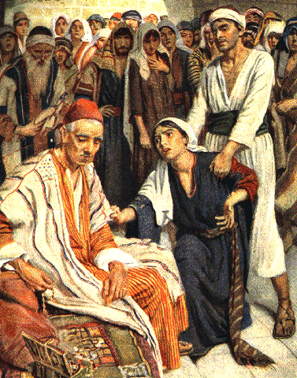
Overcoming Weariness
Always pray . . .
Never lose heart.
Luke 18:1 NRSV
Notes:
Luke 18: 1 Then Jesus told them a parable about their need to pray always and not to lose heart.
2 He said, "In a certain city there was a judge who neither feared God nor had respect for people.
3 In that city there was a widow who kept coming to him and saying, "Grant me justice against my opponent.'
4 For a while he refused; but later he said to himself, "Though I have no fear of God and no respect for anyone,
5 yet because this widow keeps bothering me, I will grant her justice, so that she may not wear me out by continually coming.' "
6 And the Lord said, "Listen to what the unjust judge says.
7 And will not God grant justice to his chosen ones who cry to him day and night? Will he delay long in helping them?
8 I tell you, he will quickly grant justice to them.

Slide 25
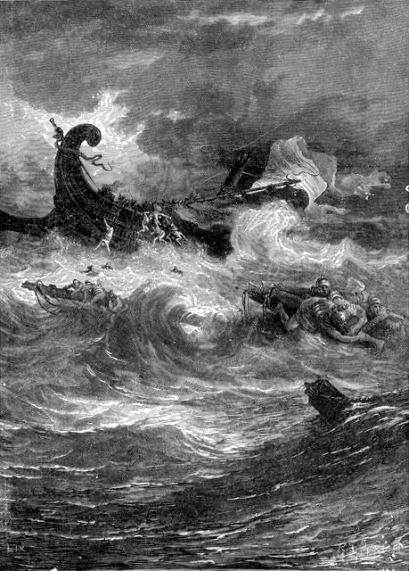
Overcoming Weariness
Since it is by God’s mercy we are engaged in this ministry, we do not lose heart.
2 Corinthians 4:1 NRSV
Notes:
2 Corinthians 3:17 Now the Lord is the Spirit, and where the Spirit of the Lord is, there is freedom. 3:18 And all of us, with unveiled faces, seeing the glory of the Lord as though reflected in a mirror, are being transformed into the same image from one degree of glory to another; for this comes from the Lord, the Spirit.
2 Corinthians 4:1 Therefore, since it is by God's mercy that we are engaged in this ministry, we do not lose heart.
2 Corinthians 11:23Are they servants of Christ?—I speak as if insane—I more so; in far more labors, in far more imprisonments, beaten times without number, often in danger of death. 24Five times I received from the Jews thirty-nine lashes. 25Three times I was beaten with rods, once I was stoned, three times I was shipwrecked, a night and a day I have spent in the deep. 26I have been on frequent journeys, in dangers from rivers, dangers from robbers, dangers from my countrymen, dangers from the Gentiles, dangers in the city, dangers in the wilderness, dangers on the sea, dangers among false brethren; 27I have been in labor and hardship, through many sleepless nights, in hunger and thirst, often without food, in cold and exposure. 28Apart from such external things, there is the daily pressure on me of concern for all the churches. 29Who is weak without my being weak? Who is led into sin without my intense concern?

Slide 26
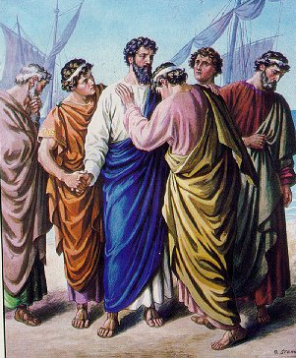
Overcoming Weariness
None of these things move me, neither count I my life dear unto myself, so that I might finish my course with joy, and the ministry, which I have received of the Lord Jesus to testify of the gospel of the grace of God.
Acts 20:24 NRSV
Notes:
Acts 20:22 And now, as a captive to the Spirit, I am on my way to Jerusalem, not knowing what will happen to me there, 23 except that the Holy Spirit testifies to me in every city that imprisonment and persecutions are waiting for me. 24 But I do not count my life of any value to myself, if only I may finish my course and the ministry that I received from the Lord Jesus, to testify to the good news of God's grace.
25 "And now I know that none of you, among whom I have gone about proclaiming the kingdom, will ever see my face again.

Slide 27
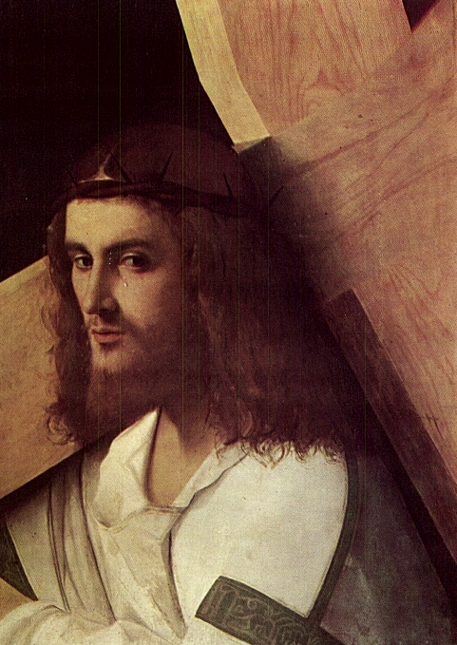
Overcoming Weariness
Look to Jesus the pioneer and perfecter of our faith, who for the sake of the joy that was set before him endured the cross, disregarding its shame, and has taken his seat at the right hand of the throne of God.
Hebrews 12:2 NRSV
Notes:
Hebrews 12:1 Therefore, since we are surrounded by so great a cloud of witnesses, let us also lay aside every weight and the sin that clings so closely, and let us run with perseverance the race that is set before us,
2 looking to Jesus the pioneer and perfecter of our faith, who for the sake of the joy that was set before him endured the cross, disregarding its shame, and has taken his seat at the right hand of the throne of God.
3 Consider him who endured such hostility against himself from sinners, so that you may not grow weary or lose heart.
4 In your struggle against sin you have not yet resisted to the point of shedding your blood

Slide 28
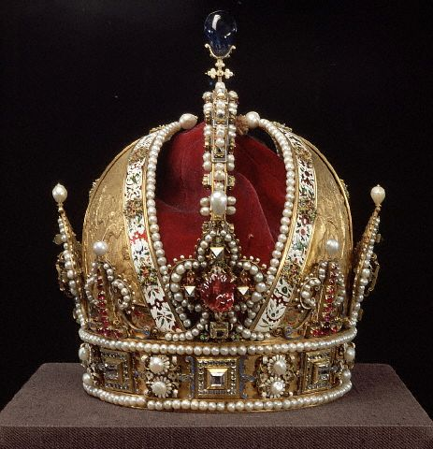
Overcoming Weariness
And when the chief Shepherd shall appear, you shall receive a crown of glory that fades not away.
I Peter 5:4 - MKJV
Notes:
What is your joy?

Slide 29
Overcoming Weariness
Consider him who endured such hostility against himself from sinners, so that you may not grow weary or lose heart.
Hebrews 12:3 NRSV
Notes:
Hebrews 12:1 Therefore, since we are surrounded by so great a cloud of witnesses, let us also lay aside every weight and the sin that clings so closely, and let us run with perseverance the race that is set before us,
2 looking to Jesus the pioneer and perfecter of our faith, who for the sake of the joy that was set before him endured the cross, disregarding its shame, and has taken his seat at the right hand of the throne of God.
3 Consider him who endured such hostility against himself from sinners, so that you may not grow weary or lose heart.
4 In your struggle against sin you have not yet resisted to the point of shedding your blood

Slide 30
Overcoming Weariness
Whom have I in heaven but you? And there is nothing on earth that I desire other than you.
My flesh and my heart may fail, but God is the strength of my heart and my portion forever.
Psalm 73:24-26 - NRSV

Slide 32
Overcoming Weariness – Fretting Because of Evil Doers
Psalm 37:1, 7-8

